Slide 1
ab initio folding
Shourya S. Roy Burman

Slide 2
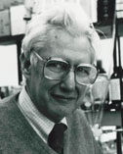

Folding from sequence
If we start from pose_from_sequence("<sequence>"), can we use φ,ψ, and χ_{i} moves to a ultimately arrive at the folded protein structure?
Image: National Academy of Sciences, Wikimedia

Slide 3
Assumptions in Rosetta’s ab initio folding
We rely on two key observations:
Local sequence biases the protein backbone towards a small number of conformations, and
Non-local interactions preferentially stabilize native-like global structure.

Slide 4
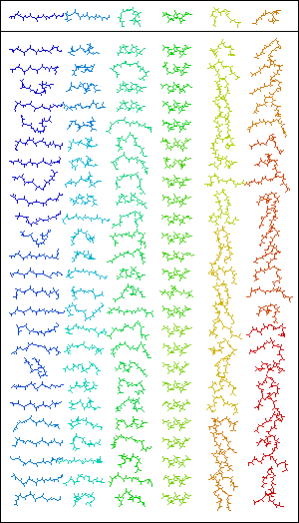
Fragment insertion
Local sequence bias: 9-mer and 3-mer backbone fragments observed in nature
Fragments are copied from sequence stretches with similar residue composition and then idealized (bond angles & lengths)
Image: Meiler Lab

Slide 5
>1QGM:A|PDBID|CHAIN|SEQUENCE
VIHCDAATICPDGTTCSLSPYGVWYCSPFS
position: 1 neighbors: 200
2od4 A 60 I E -120.870 117.147 -177.549 -0.434 4.995 10.540 3 0.000 P 1 F 1
2od4 A 61 I E -115.529 134.830 -179.960 -0.434 4.995 10.540 3 0.000 P 1 F 1
2od4 A 62 H E -104.828 134.313 -179.099 -0.434 4.995 10.540 3 0.000 P 1 F 1
1t6t 1 106 I L -97.084 96.468 -172.890 -0.717 4.571 12.132 4 0.000 P 1 F 2
1t6t 1 107 I L -76.459 -44.000 -174.209 -0.717 4.571 12.132 4 0.000 P 1 F 2
1t6t 1 108 H L -114.937 134.882 178.374 -0.717 4.571 12.132 4 0.000 P 1 F 2
...
Secondary structure (H/L/E)
Backbone dihedrals
(φ ψ ω)
C_{α} coordinates in template
(x y z)
Unused information
Template information
(PDB chain
resi# identity)
position 1 fragment 2
(unused)

Slide 6
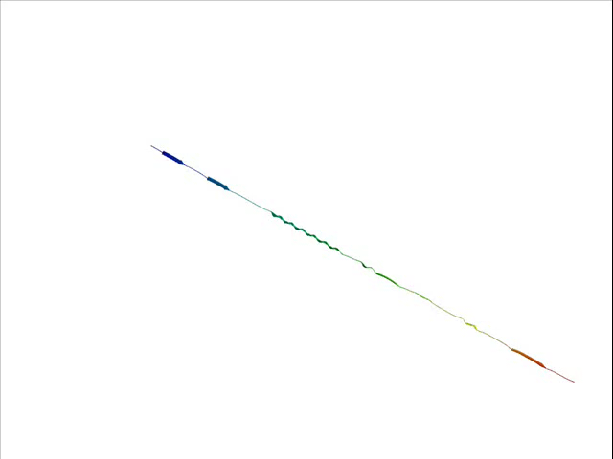
Folding ubiquitin
Video: Meiler Lab

Slide 7
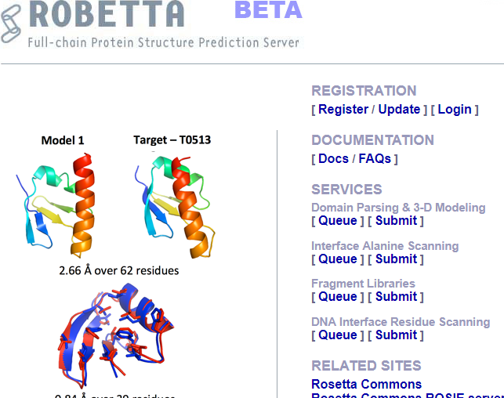
Fragment library generation
Robetta fragment libraries serve most purposes.
To generate custom fragment libraries, use the fragment picker:
$ROSETTA/main/source/src/apps/public/fragment_picker.cc
http://robetta.bakerlab.org/

Slide 8
Using fragments in PyRosetta
You are provided with 3-mer and 9-mer fragments for the target protein. To read them in use:
fragset = ConstantLengthFragSet(3)
fragset.read_fragment_file("1gqm.3mers")
To use the fragments:
mover_3mer = ClassicFragmentMover(fragset, movemap)
mover_3mer.apply(pose)

Slide 9
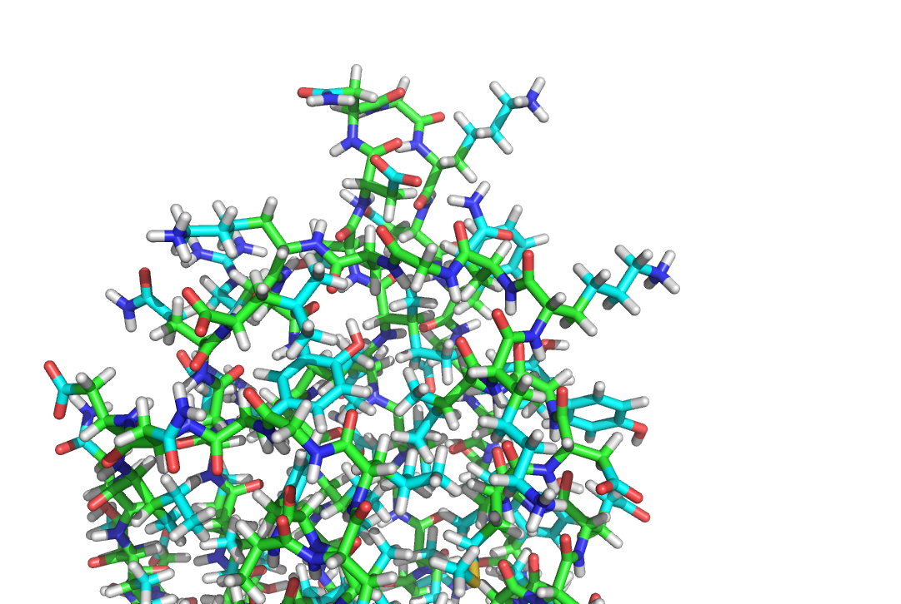
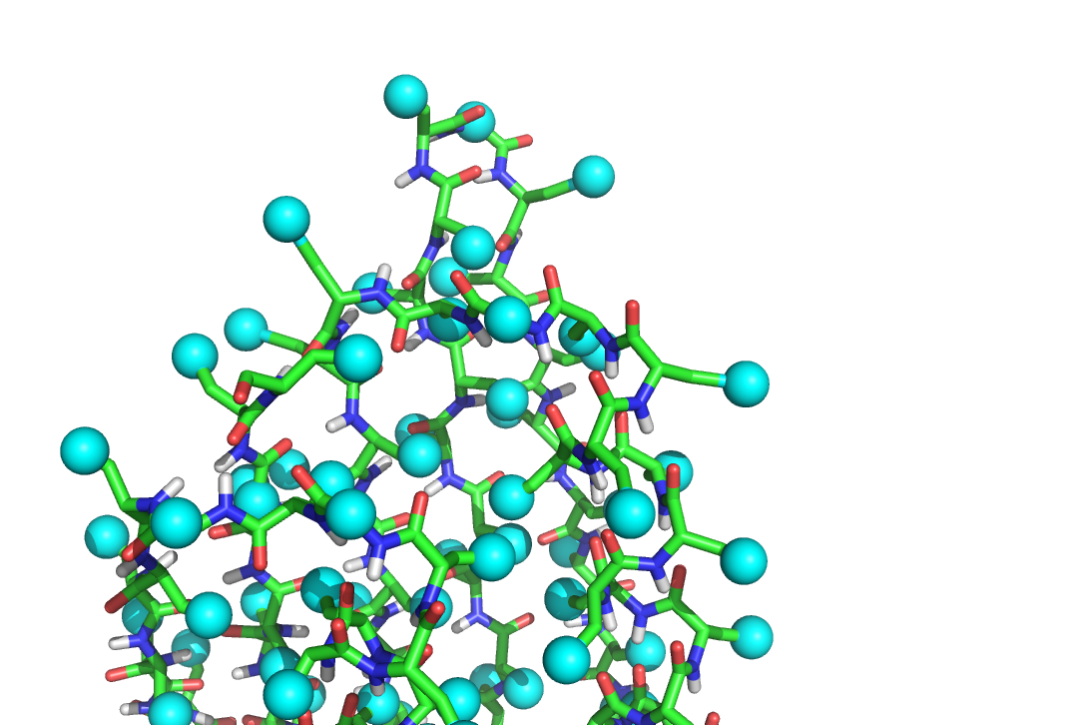
Switching between representations (a.k.a. residue type sets)
Full-atom representation
Centroid representation
(spheres not to scale)
SwitchResidueTypeSetMover("fa_standard")
SwitchResidueTypeSetMover("centroid")

Slide 10
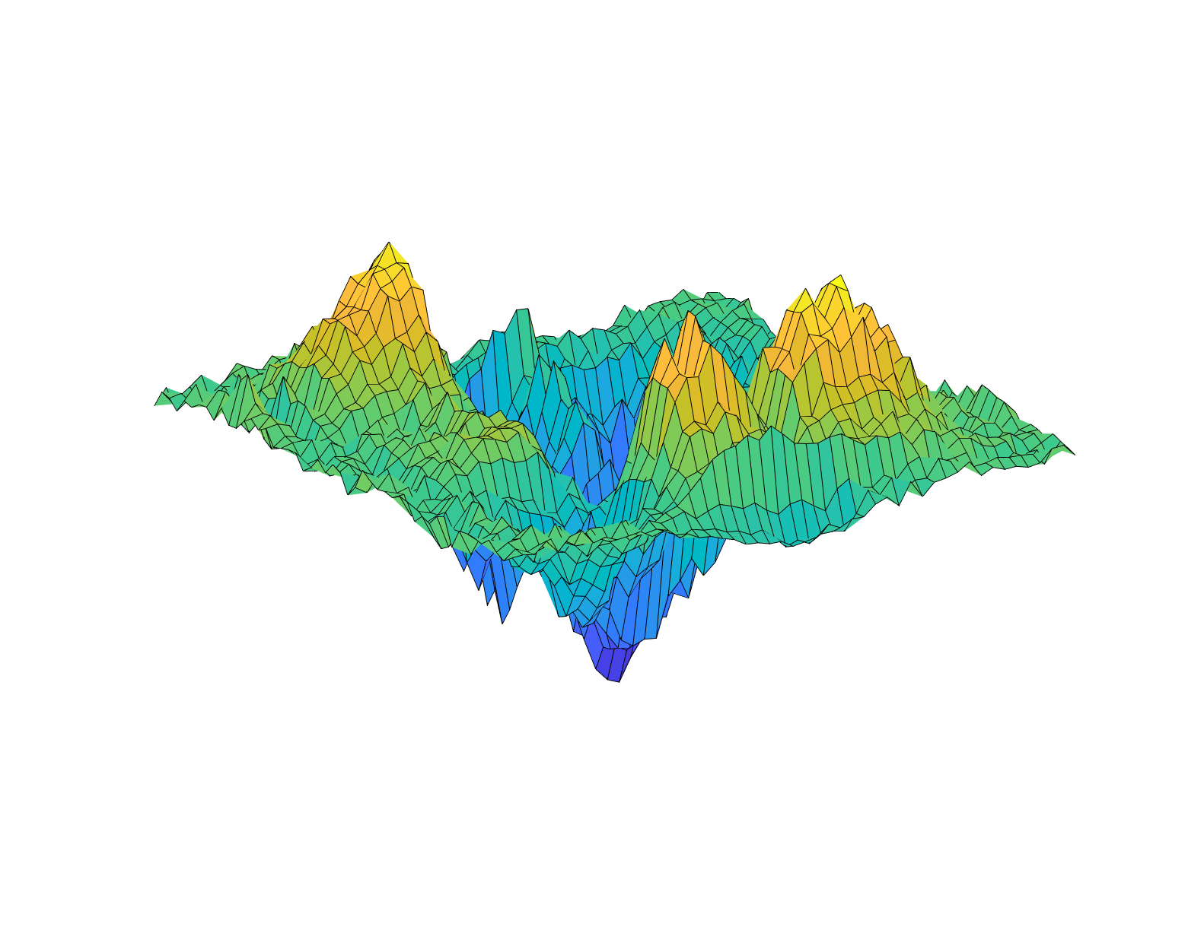
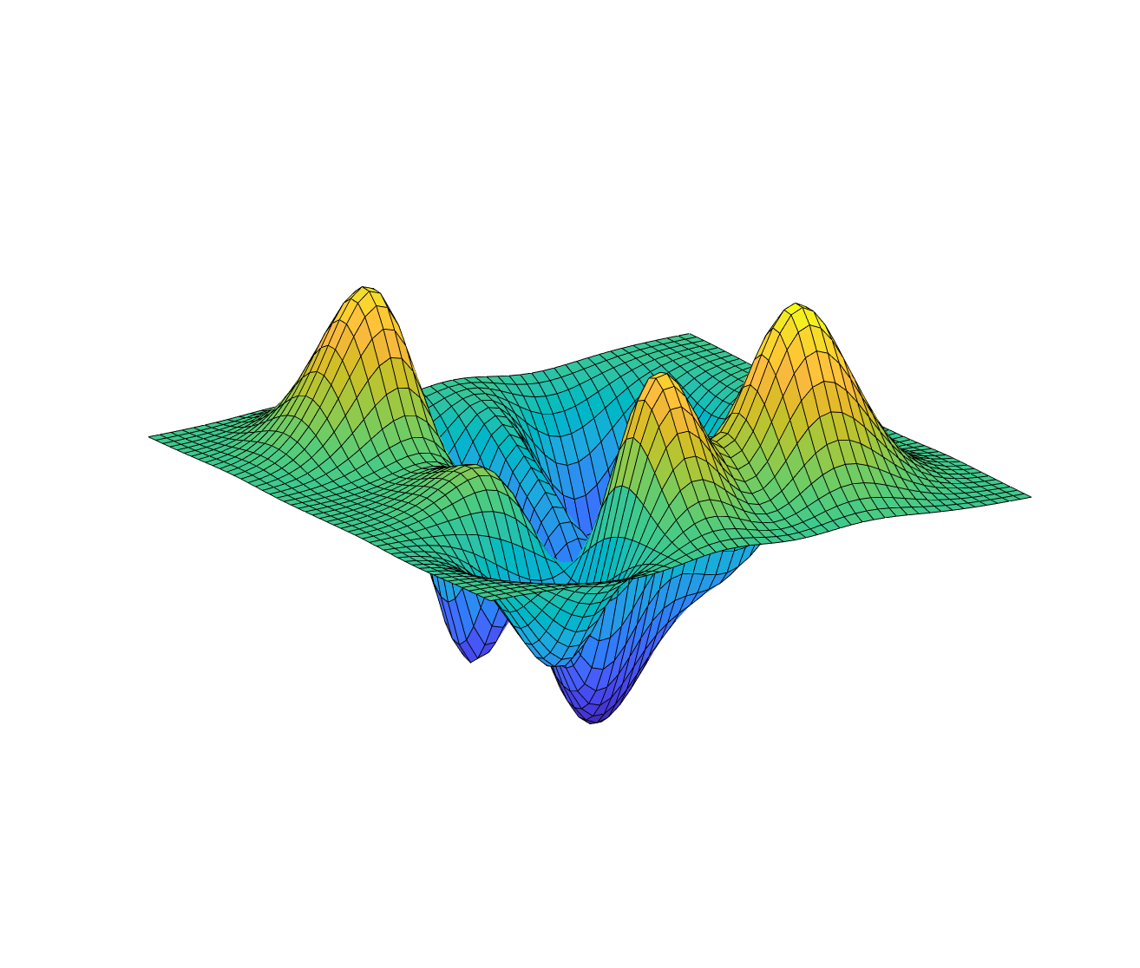
Centroid energy landscape is smoother
Full-atom energy landscape
Ideal centroid energy landscape
Why is a rugged energy landscape undesirable?

Slide 11
Centroid scoring function
# score3 from rosetta++, used in stage 4 of the ClassicAbinitio protocol.
env 1.0 # hydrophobic effect on a single residue
pair 1.0 # residue pair interactions (electrostatics and disulfide)
cbeta 1.0 # corrects for excluded volume effect
vdw 1.0 # repulsive part of van der Waals forces
rg 3.0 # radius of gyration; favors compact structures
cenpack 1.0 # packing density; favors compact structures
hs_pair 1.0 # helix-strand packing
ss_pair 1.0 # strand-strand hydrogen bonding
rsigma 1.0 # strand pair scoring based on distance and register
sheet 1.0 # prob(strands arrange into sheets); favors sheets
STRAND_STRAND_WEIGHTS 0 6 # cutoff distance for strands

Slide 12
Full-atom refinement in ab initio + relax
Centroid folding
Side chain reintroduced
Structure minimized
Side chains packed
Relax algorithm
Centroid mode
Full-atom mode

Slide 13
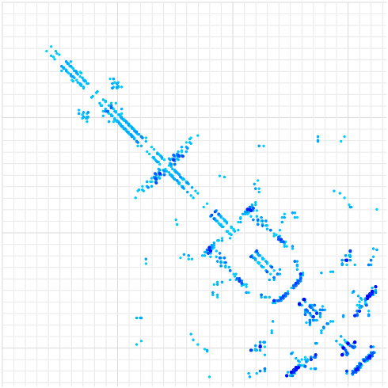
Biasing long-range interactions
GREMLIN predicts residue-residue contacts from statistical analysis of sequence co-evolution.
http://gremlin.bakerlab.org

Slide 14
Comparative modeling with RosettaCM
ab initio is almost never useful for proteins with 150+ residues. Instead
Align target sequence with sequence of known structures
Thread the target sequence onto the template backbones to create multiple structures
Use HybridizeMover to sample structural combinations of multiple templates
Rebuild loops and other missing segments (with fragment insertion)
Refine
Cluster

Slide 15
Resources
Centroid vs. FA: https://www.rosettacommons.org/demos/latest/tutorials/full_atom_vs_centroid/fullatom_centroid
Centroid score terms: https://www.rosettacommons.org/docs/latest/rosetta_basics/scoring/centroid-score-terms
ab initio + relax: https://www.rosettacommons.org/docs/latest/application_documentation/structure_prediction/abinitio-relax
Fragment file: https://www.rosettacommons.org/docs/latest/rosetta_basics/file_types/fragment-file
Fragment picking: https://www.rosettacommons.org/docs/latest/application_documentation/utilities/app-fragment-picker
RosettaCM: https://www.rosettacommons.org/docs/latest/application_documentation/structure_prediction/RosettaCM

